Slide 1
LF Energy
A Linux Foundation Project to accelerate the Energy Transition

Slide 2
The Linux Foundation’s goal is to create the greatest shared technology investment in history by enabling open collaboration across companies, developers and users.
We are the nonprofit organization of choice to build ecosystems that accelerate open source technology development and commercial adoption on a global scale.

Slide 3





























































































Security
Networking
Cloud
Automotive
Blockchain
Edge/IoT
Web
AI
Film
CI/CD
Energy
Hardware
Standards
LF beyond Linux

Slide 4

Mission/Vision
The Linux Foundation’s mission is to support the world’s most important shared technology collaborations.
LF Energy’s mission is to create a technology ecosystem to support rapid decarbonization that benefits the environment, enables economic prosperity, and leads to social well-being for future generations.
Reference: Climate Tech Review overview of LF Energy for the Climate Tech 100
Linux Foundation Energy is a vendor-neutral, non-profit organization that brings together energy producers, utilities, end users, academia, government and the technology industry to collaboratively develop technology solutions – including software solutions, standards, and specifications – for the energy sector to speed decarbonization and the energy transition generally.

Slide 5
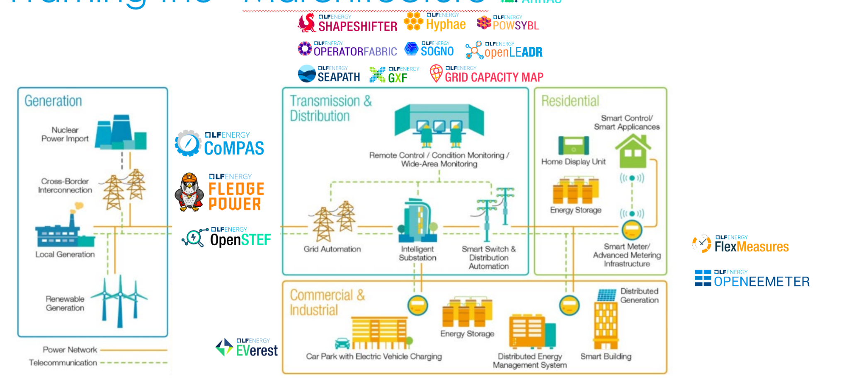

Why LF Energy?
Energy Ecosystem is now a software challenge & speed of innovation is key!
The energy transition requires collaborative, open, and neutral solutions to achieve decarbonization.
Open collaboration accelerates innovation to scale, modernize, and digitally transform the energy sector through software orchestration.
LF Energy builds communities to develop open technologies, frameworks, reference architectures, and research to alleviate pain points and identify the most urgent priorities to digitally transform the energy sector. This includes cybersecurity, interoperability, control, automation, virtualization, flexibility, and digital orchestration for balancing of supply and demand, which cannot be solved by legacy, proprietary solutions.
LF Energy Key Stats:
Hosting 30 open source projects covering the energy systems tech stack from generation to distribution to end use
75+ members, including utilities, research organizations, traditional energy system vendors, and technology vendors
Annual increases of:
Contributors - 29%
Lines of code - 60 million
Members - 19%
Where We Add Value:
Neutral governance providing a home for collaboration across all stakeholders from utilities to researchers, vendors, government, and more
Project management and hosting infrastructure
Legal support including licensing, trademarks, etc.
Communications support including events, thought leadership, etc.
Community management, to encourage growth, innovation, and determining priorities and direction

Slide 6

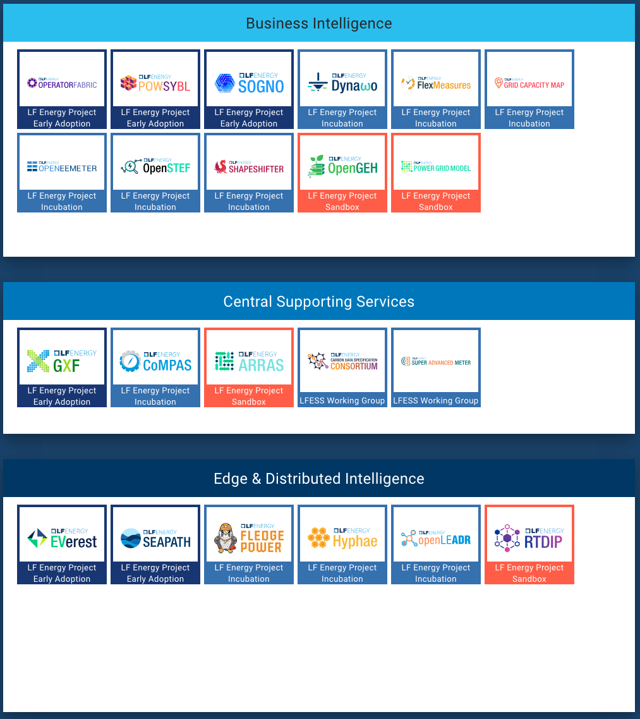
Application
Catalogue
SECURITY
Data &
Services
Infrastructure
Source: https://landscape.lfenergy.org/softwarestack

Slide 7
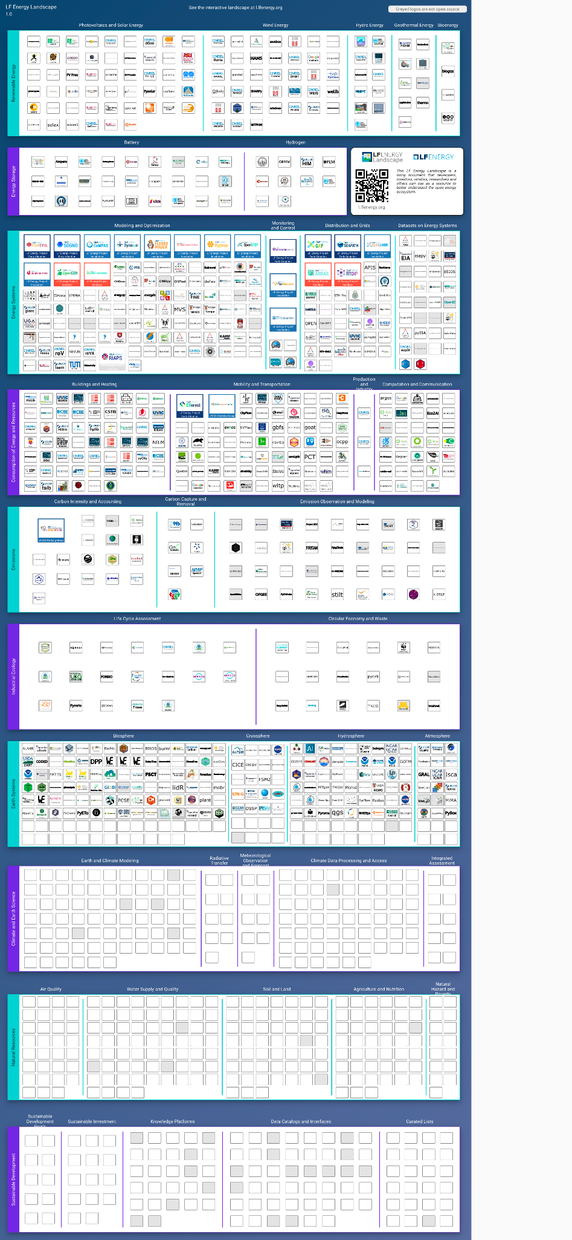
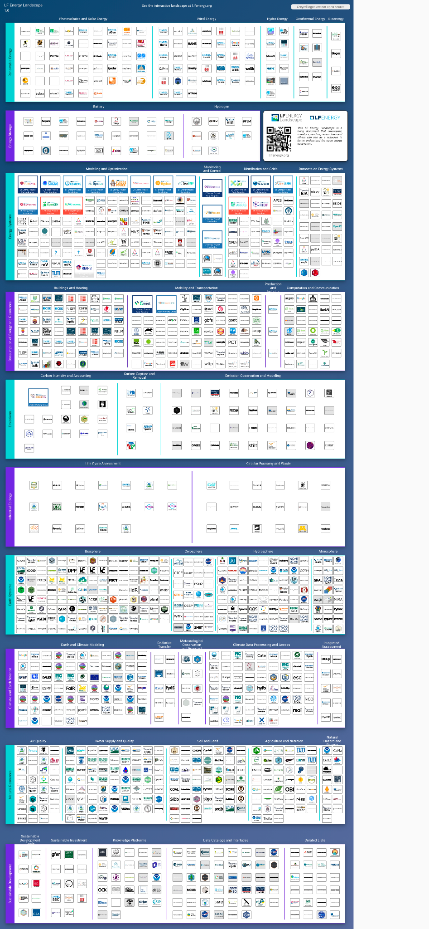

LF Energy Landscape
l.lfenergy.org
1,343 projects, market cap of $7.5T and funding of $17B.
Notes:
Source: https://landscape.lfenergy.org/fullscreen/

Slide 8
Governance & Membership

Slide 9
Governance at a Glance
Fiduciary Governance - Membership driven
Technical Governance - Open to all
Governing Board
Technical Advisory Council (TAC)
Budget Committee
LF Energy Standards and Specifications (LFESS)
Steering Committee
Technical Projects
Working Groups/SIGs
Marketing Advisory Committee (MAC)
Standards
Working Groups

Slide 10
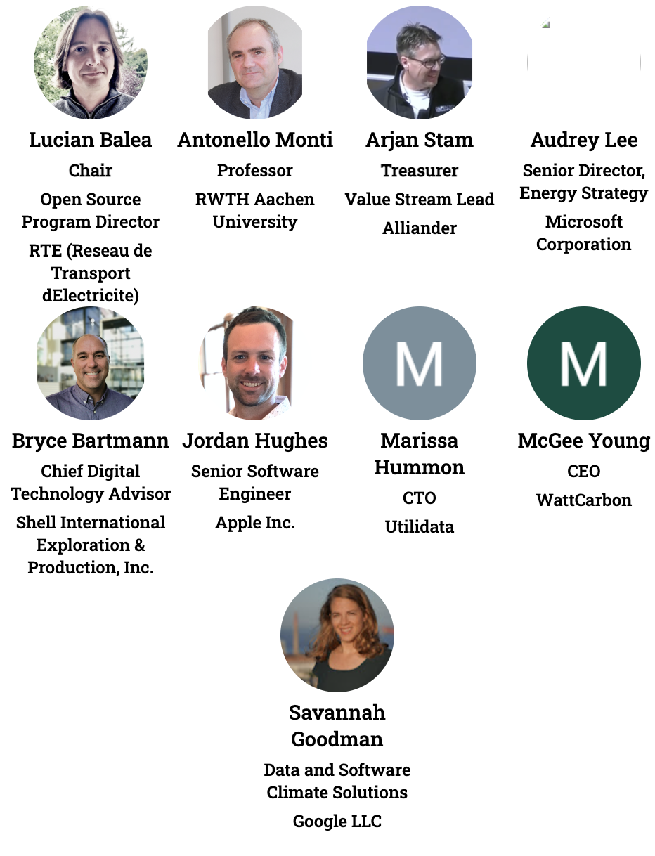



Governing Board
voting representatives
Notes:
https://jmertic.github.io/committee-gallery/lf-energy-foundation-governing-board
Zoom to fit

Slide 11
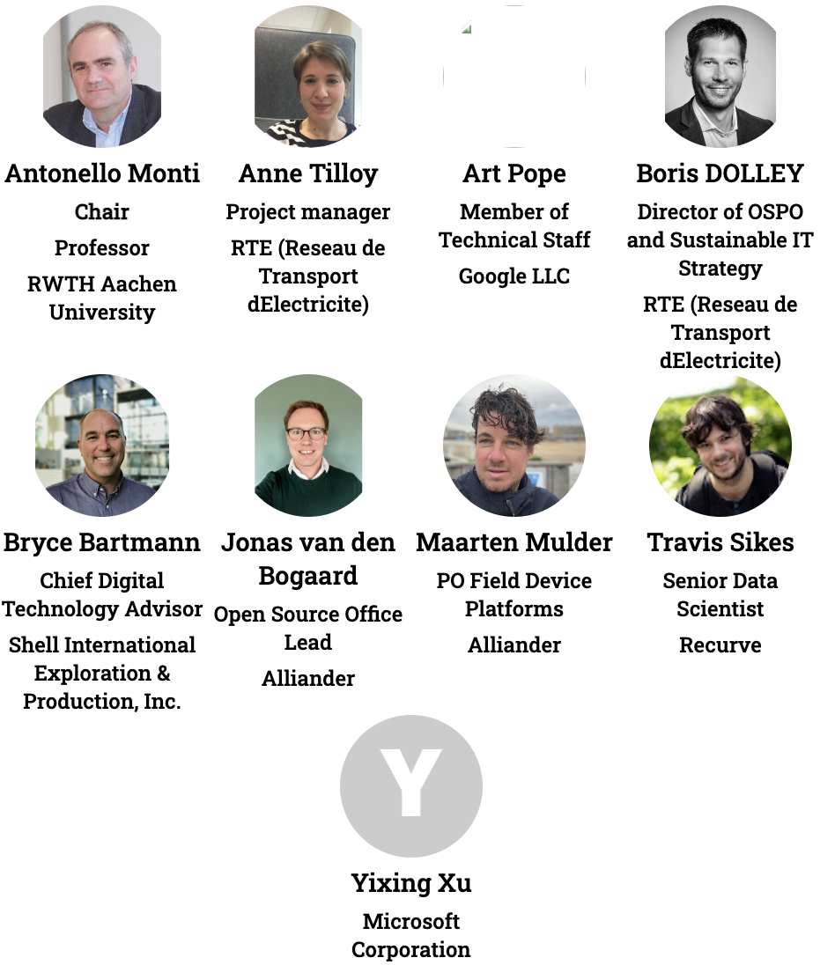


Technical Advisory Council (TAC)
voting representatives
Notes:
https://jmertic.github.io/committee-gallery/lf-energy-foundation-tac
Zoom to fit

Slide 12
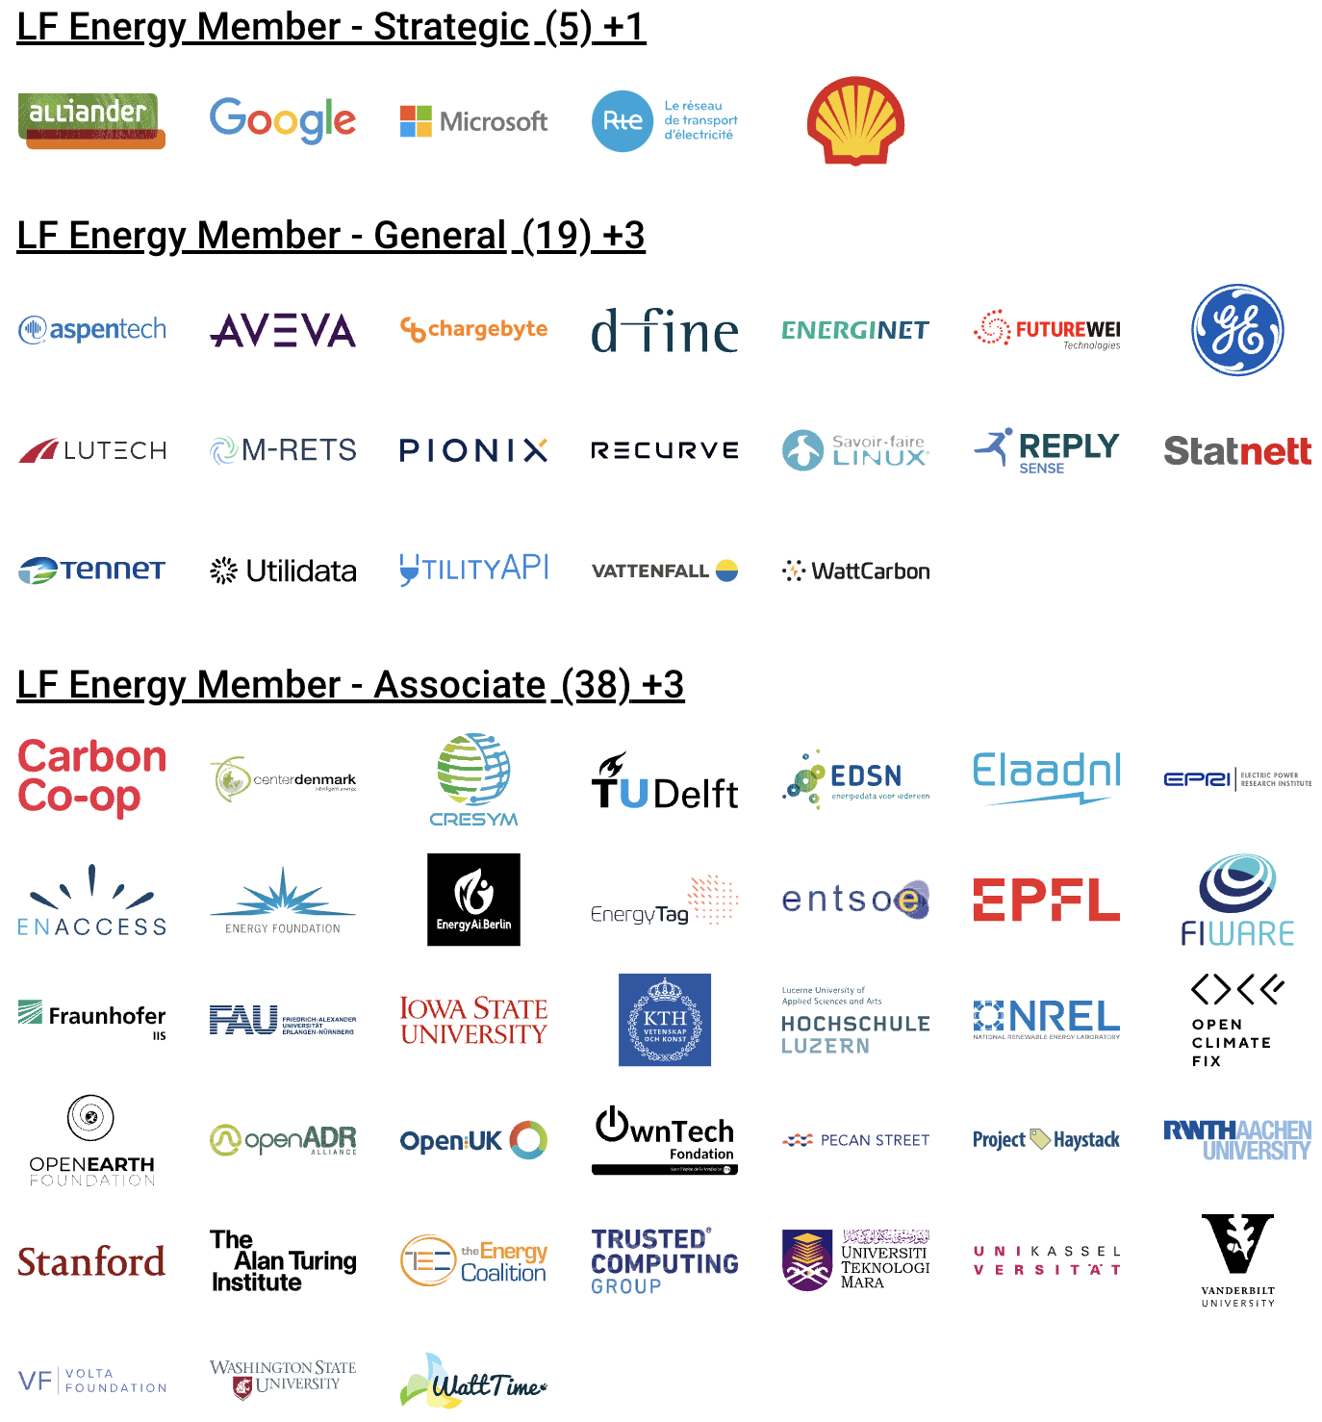
LF Energy Members
Notes:
Source: https://landscape.lfenergy.org/pages/members?style=body%7Bbackground-color:white;%7D.borderless-mode%20.mosaic%20.logo%7Bheight:100px;%7D.sh_wrapper%20span%7Bfont-size:40px!important;text-decoration:underline;color:black;%7D%23embedded-footer%7Bdisplay:none;%7D.borderless-mode%20.mosaic-wrap%20%7B%20padding:%2010px%2020px}div%5Bdata-wrapper-id%3Dlf-energy-member-strategic%5D%20.items-cont%3Aafter%7Bcontent%3A%22%20%2B1%22%3B%7Ddiv%5Bdata-wrapper-id%3Dlf-energy-member-general%5D%20.items-cont%3Aafter%7Bcontent%3A%22%20%2B3%22%3B%7Ddiv%5Bdata-wrapper-id%3Dlf-energy-member-associate%5D%20.items-cont%3Aafter%7Bcontent%3A%22%20%2B3%22%3B%7D

Slide 13
Membership and Participation Levels
Membership Level | Annual Fee | Plus Linux Foundation Membership: Silver (if not a member) | Board Seat | TAC Seat | Outreach Committee | Suggested Minimum FTE* | Notes
Strategic | Flat fee: $150k | $20k | Yes | Yes | Yes | 1 | Two year minimum commitment
General | Based on number of employees $50K (5000+) $30K (1000–4999) $20K (200–999) $10K (100–199) $5,000 (0-99) | Based on number of employees $20K (5000+) $15K (499-4999) $10K (100-499) $5,000 (0-99) | (Possible) 1 per every 10 General members | Based on Merit | Yes | N/A | A TAC seat may be earned by technical contribution as a project leader
Associate | No fee | No | (Provisional at start-up) | Based on Merit | Yes | N/A | Limited to academic, research and NGO organizations
* FTE = Full Time Equivalent (e.g. 2 employees each spend 50% of their time on a project). This suggestion is meant to provide a minimum resource investment to ensure members are contributing technically. Most projects see much higher investment of resources than the minimum requirement.

Slide 14
Membership Benefits
Tier | New to LF | Existing LF member | Benefits
Strategic | $170,000 | $150,000 | Appoint one (1) voting representative to the LF Energy Governing Board. Appoint one (1) voting representative to the LF Energy Technical Advisory Council (TAC) Appoint one (1) representative as a voting member in any subcommittees or activities of the Governing Board. Enjoy most prominent placement in displays of membership including on the website and in marketing materials. 1 guest LF Energy blog post per quarter 1 LF Energy hosted webinar per quarter 1 Linux.com blog post per year 10 complementary LF Training course/certification tickets Create an individualized press release to announce membership with LF Energy PR. Receive greater insight into LF Energy strategy and project roadmaps through increased engagement with the LF Energy Executive Director and staff. Receive ongoing, monthly 1:1, individual engagement and guidance from LF Energy Executive Director Increased access to invitation-only Linux Foundation Member Summit. Receive discounts on LF Energy conferences + event sponsorship.
General | $70,000 (USD) 5,000+ $40,000 (USD) 2,000 – 4,999 $25,000 (USD) 500 – 1,999 $15,000 (USD) 100 – 499 $10,000 (USD) Up to 99 | $50,000 (USD) 5,000+ $25,000 (USD) 2,000 – 4,999 $10,000 (USD) 500 – 1,999 $5,000 (USD) 100 – 499 $5,000 (USD) Up to 99 | (Possible) Governing Board seat 1 per every 10 General and Academic and Research Institutions members collectively as a class, with a maximum of 3. 1 guest LF Energy blog post per year 1 LF Energy hosted webinar per year 10 complementary LF Training course/certification tickets Participate in all marketing, community, thought leadership opportunities. Receive discounts on LF Energy conferences + event sponsorship. Identify your organization as a member and display your logo on the LF Energy website and in marketing materials. Access to The Linux Foundation’s invitation-only Linux Foundation Member Summit.
Associate | Free | Free | The Associate category of membership is limited to non-profit/non-governmental organizations. This requires approval by the Governing Board. Participate in all marketing, community, thought leadership opportunities. Receive discounts on LF Energy event sponsorship. Identify your organization as a member and display your logo on the LF Energy website and in marketing materials.

Slide 15
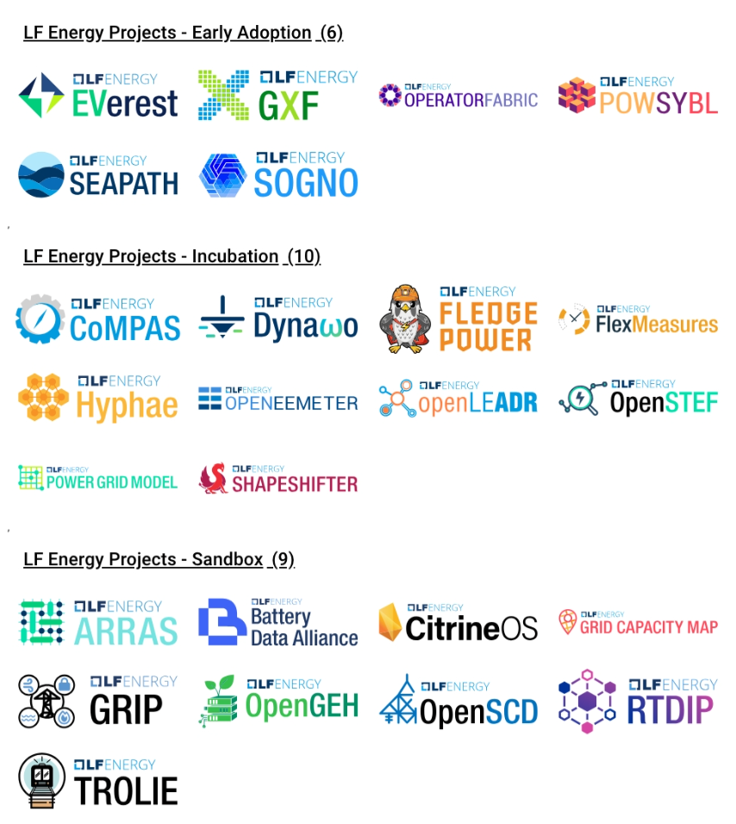
LF Energy Projects
Notes:
https://landscape.lfenergy.org/pages/hosted-projects?style=body{background-color:white;}.borderless-mode%20.mosaic%20.logo{height:100px;}.sh_wrapper%20span{font-size:24px!important;text-decoration:underline;color:black;}%23embedded-footer{display:none;}.borderless-mode%20.mosaic-wrap%20{%20padding:%200px%2010px;}

Slide 16
Contribute to our projects - anyone can!
Contribute to an existing project:
Submit a PR with a bugfix or new feature
Pick existing GitHub issue as a sample project
Integrate with a new app / contribute plugin
Help improve project documentation
Submit additional test cases
Join the TSC discussion: dev mailing list, conf calls
Get involved with the TAC or Working Group:
DevOps / CI expertise always useful
Interest / expertise in security especially welcome
Join the TAC discussions: mailing list, conf calls
More information at https://wiki.lfenergy.org/display/HOME/Technical+Projects

Slide 17




Contact Us
LF Energy Foundation
1 Letterman Drive Building D, Suite D4700 San Francisco CA 94129 Phone/Fax: +1 415 7239709 www.lfenergy.org
General Inquiries
info@lfenergy.org
Membership
membership@lfenergy.org

